Slide 1

Gender Pay Gap in the UK
21-22 Year

Slide 2

Overview
Our goal was to examine the gender pay gap within companies throughout the United Kingdom.
We identified which companies are reporting an average gender pay gap which may be considered extreme.
The size and location of the company was included in the considerations as well as some consideration for the type of company.
Our recommendation for data collection will be included at the end.

Slide 3
Data Specifics
The data used refers to the 21-22 year.
There are a total of 10,174 companies which reported for this year. 9,813 of them reported before the deadline, which is slightly up from the previous year.
The information relating to bonuses within the data is uncertain, so we elected to not include it in our analysis.
Our report includes information relating to the median percentage difference between male and female hourly pay as well as the mean used in specific circumstances.
https://www.bbc.com/news/business-58786739

Slide 4
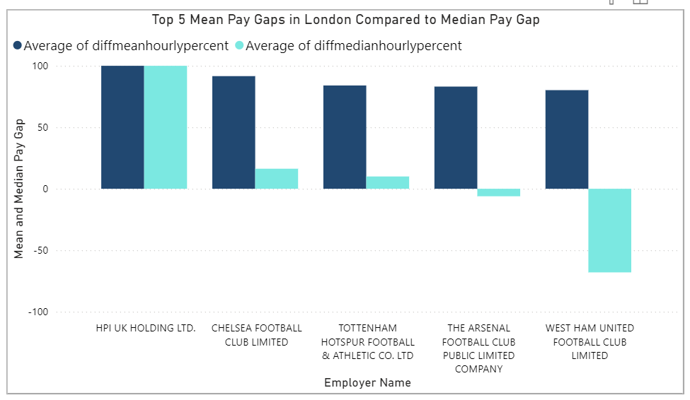
DEFINING Pay Gap
The average difference in median pay for the year was 12.3% according to our data.
This is the difference in earnings between men and women at the middle ranking of the company.
The mean may be deceiving. Also, the most recognizable businesses have deceptively high means.

Slide 5
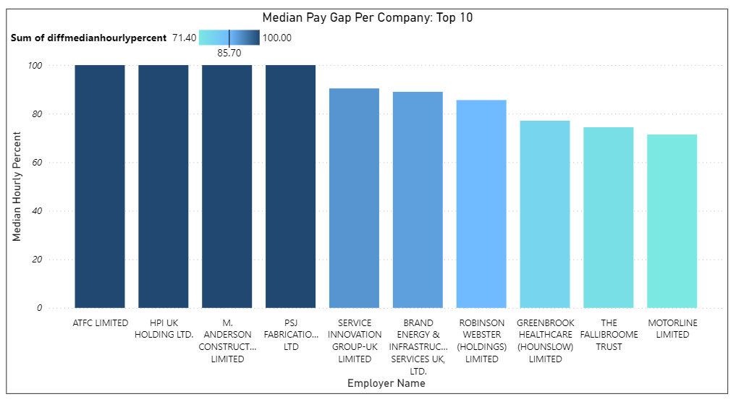
Companies with the largest gaps
Many of these companies employ a wide majority of males over females, some of which may have no female employees at all.
Most noticeable about these companies is their type.
Is this discrimination?

Slide 6

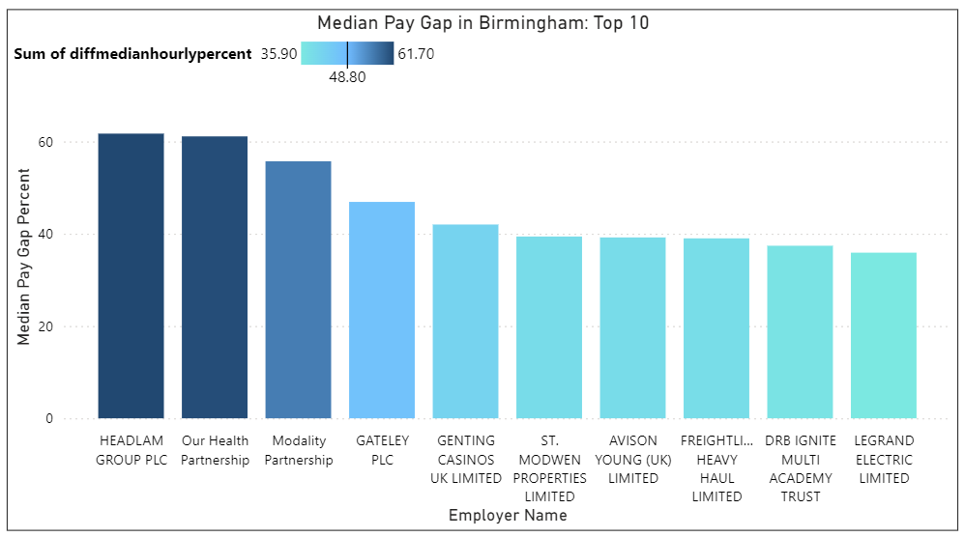
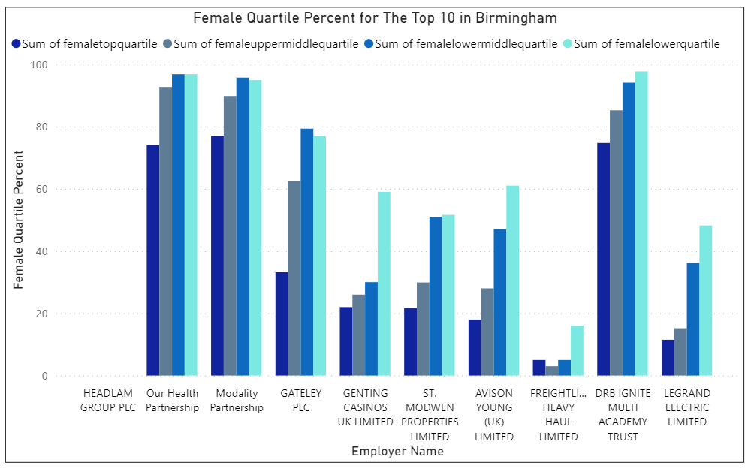
Quartiles
Quartiles reflect the ratio of people filling jobs within each pay range, here it's split between men and women.
When we consider the quartiles within a company, we are able detect the depth of the inequity between pay rates.

Slide 7

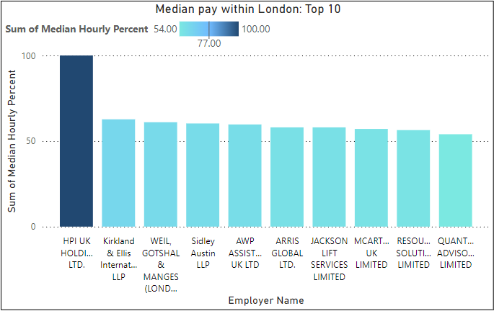
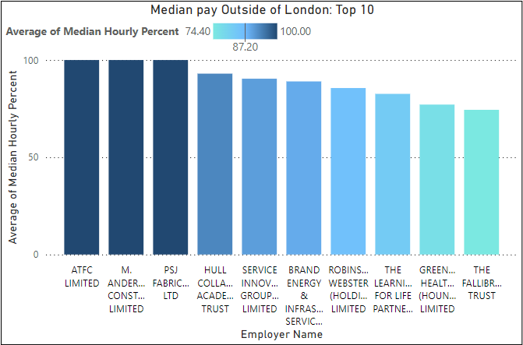
London VS The Rest of the UK

Slide 8
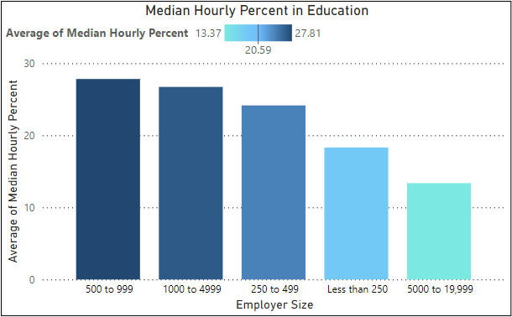
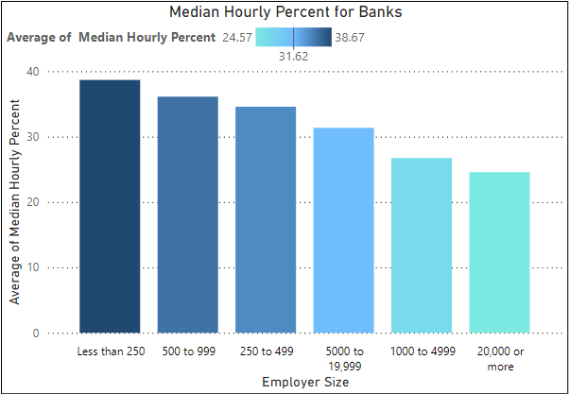
Types of Companies
Within the analysis of our data, we found that certain types of companies tend towards a higher pay gap than others.

Slide 9
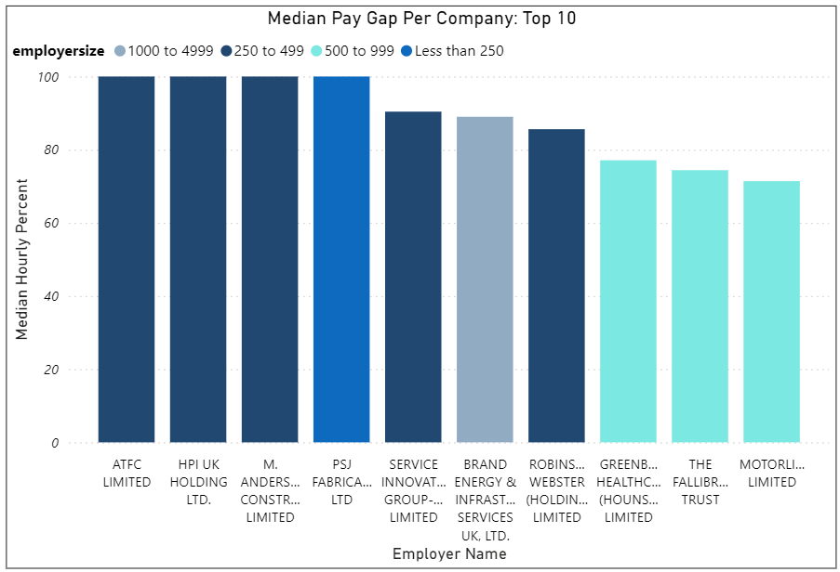
Size of Companies
We found that the larger companies showed a less pronounced gender pay gap.
The majority of the top 10 worst offenders employed less than 500 people.

Slide 10

Recommendation
Self-employed people and smaller businesses are not included
The companies themselves do the calculations which could result in incorrect or missing data
This data did not differentiate full time employees from others

Slide 11
Thank you
Pamela Berry
&
Wes Dufelmeier
DAB 812

